Slide 1
NSCI0032: Integrated Data-Driven Materials Science and Digitalisation 23/24
Hands-on session: The Atomic Simulation Environment
Instructors: Professor Hashibon, Dr Pineda Rodriguez, Dr Beynon

Slide 2

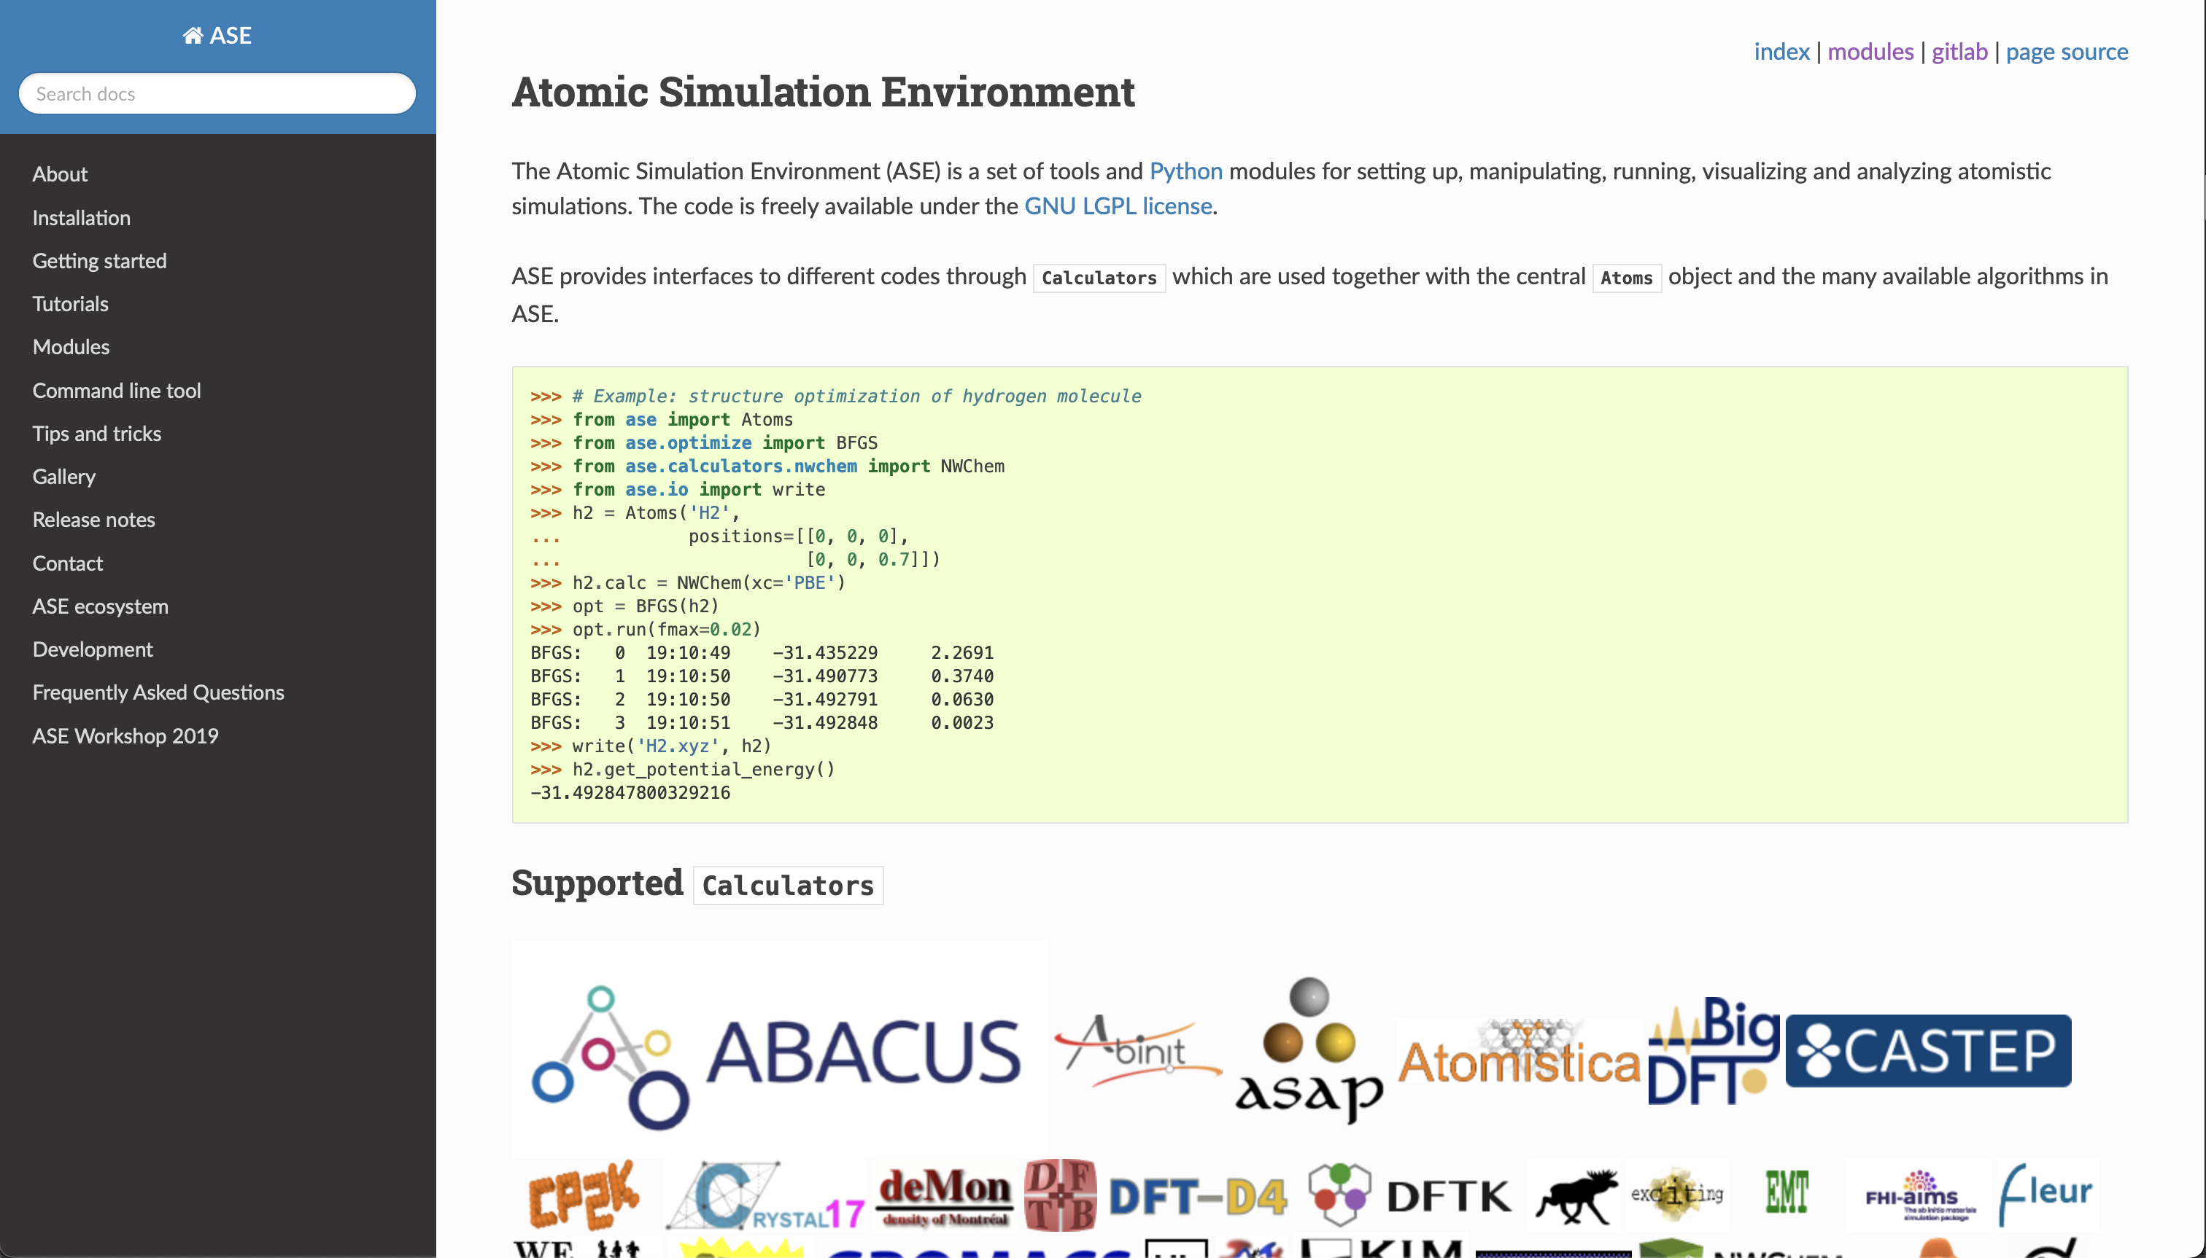
Introduction to the Atomic Simulation Environment (ASE)
https://wiki.fysik.dtu.dk/ase/

Slide 3
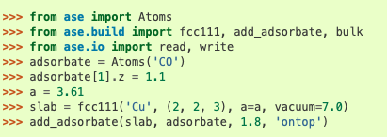
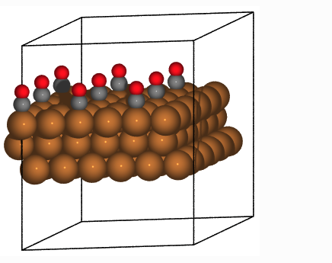
Introduction to the Atomic Simulation Environment (ASE)
Python library
Toolbox for:
Building atomic structures
Molecular dynamics
Structure optimization
Analysis
Vibrational calculations
Interface for other computational packages (e.g VASP, Gaussian, Quantum Espresso, CASTEP etc)
Adding CO molecules to a copper surface
https://wiki.fysik.dtu.dk/ase/

Slide 4
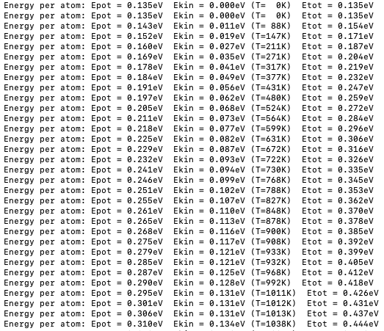
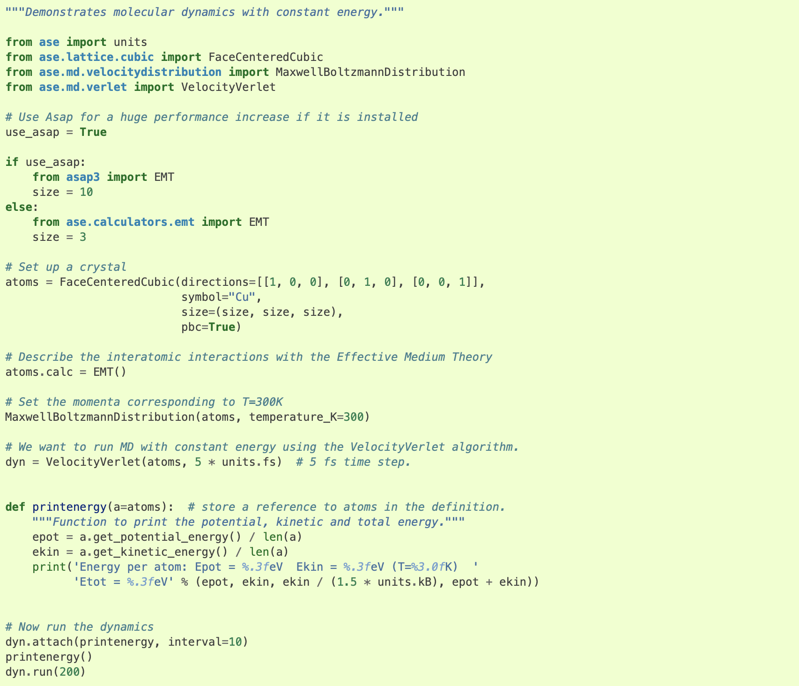
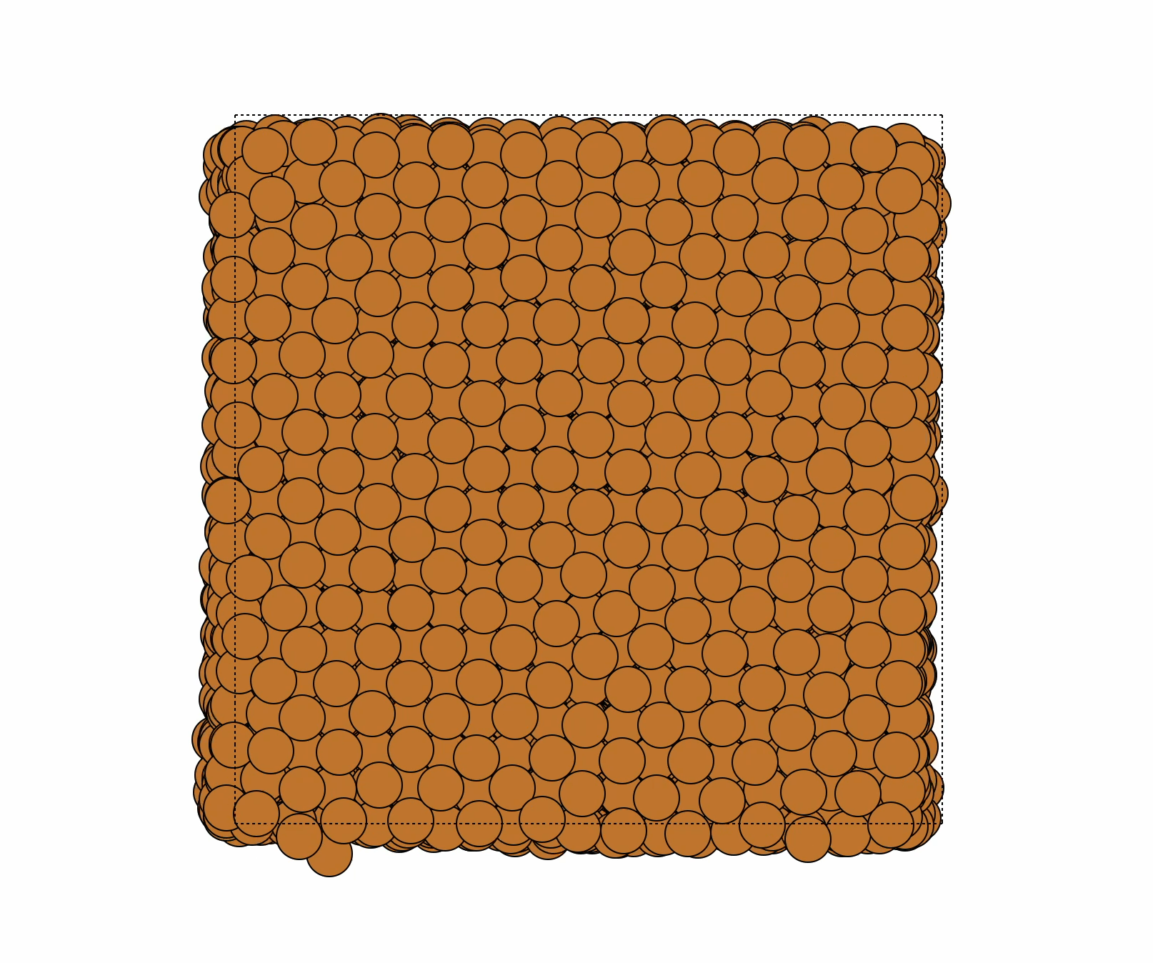
Hands-on example:
Molecular dynamics on bulk Cu using effective mean theory (EMT)
Output
Input

Slide 5
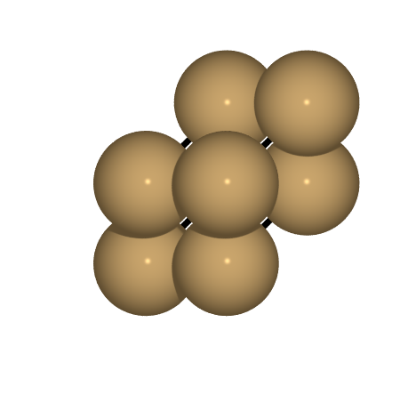
Hands-on example:
First step: Go to https://github.com/UCL-DDMD/ASE-Tutorials
Example 1:
Create unit cells of metals (Cu, Ag, Pt, Au)
Perform geometry optimisations on the unit cells
Calculate with Effective Medium Theory (EMT)
Calculate packing efficiencies of different unit cell types
Run constant temperature molecular dynamics (NVE ensemble) using Verlet algorithm

Slide 6
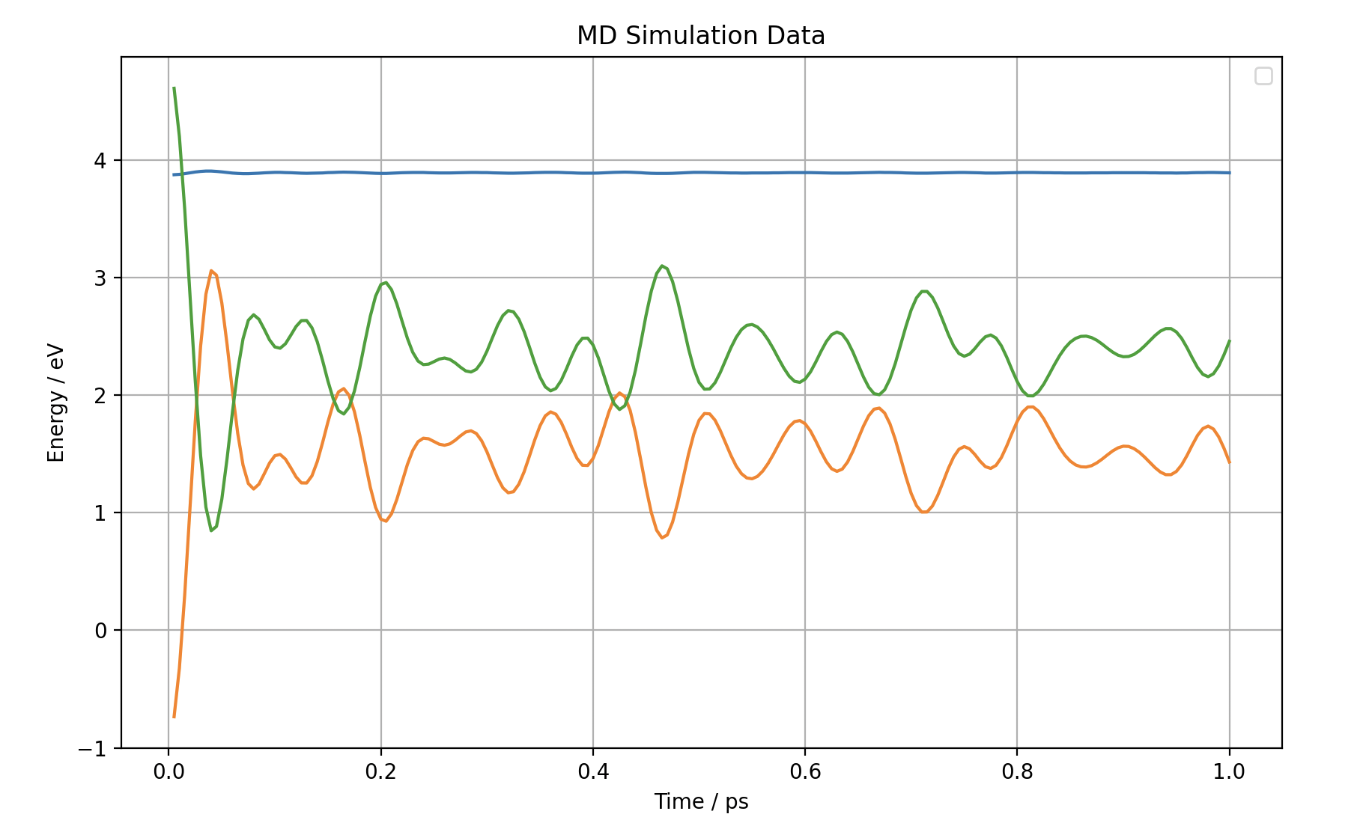
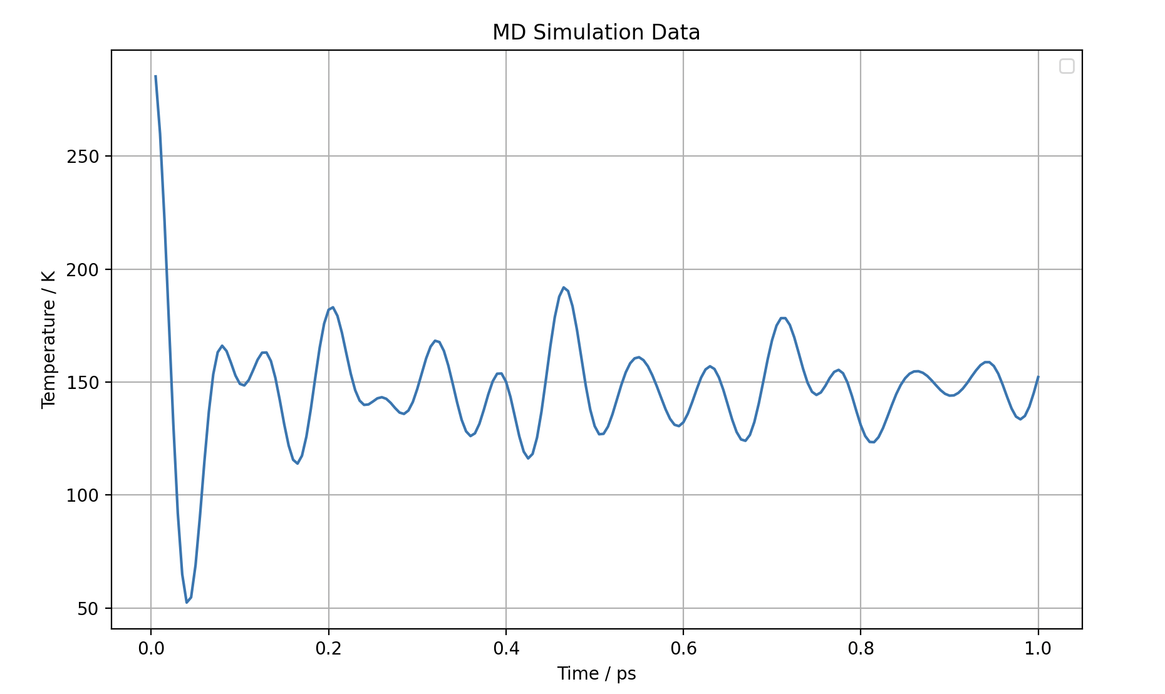
Hands-on example:
Example 2:
Plot outputs from the MD simulations
Using Python library matplotlib

Slide 7
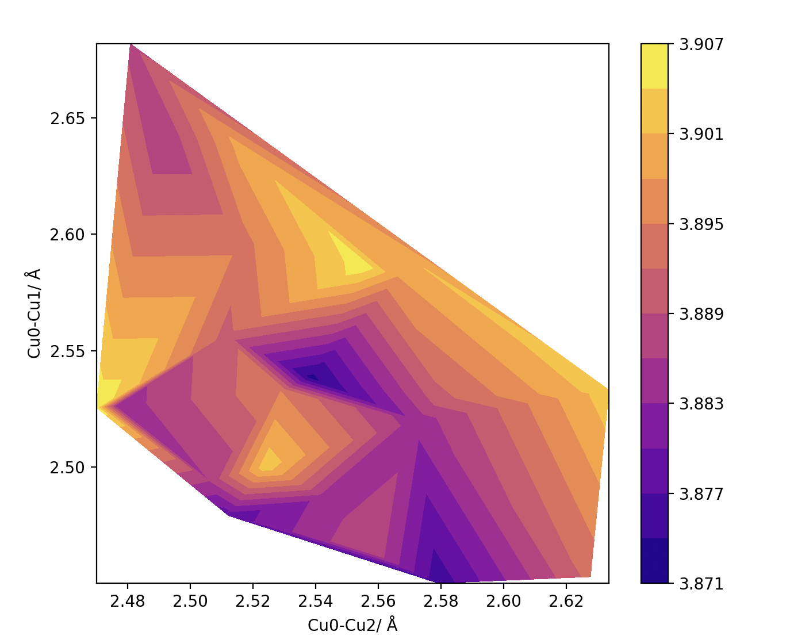
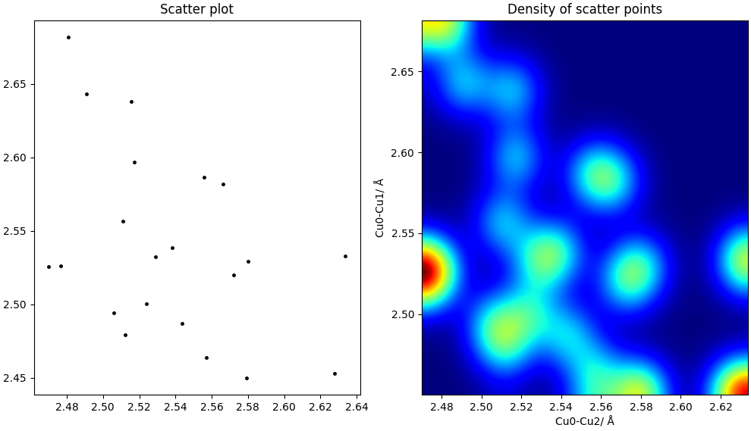
Hands-on example:
Example 3:
Plotting a 2D PES of MD simulation as a function of Metal-Metal bond length
What information can we get about the system?

Slide 8
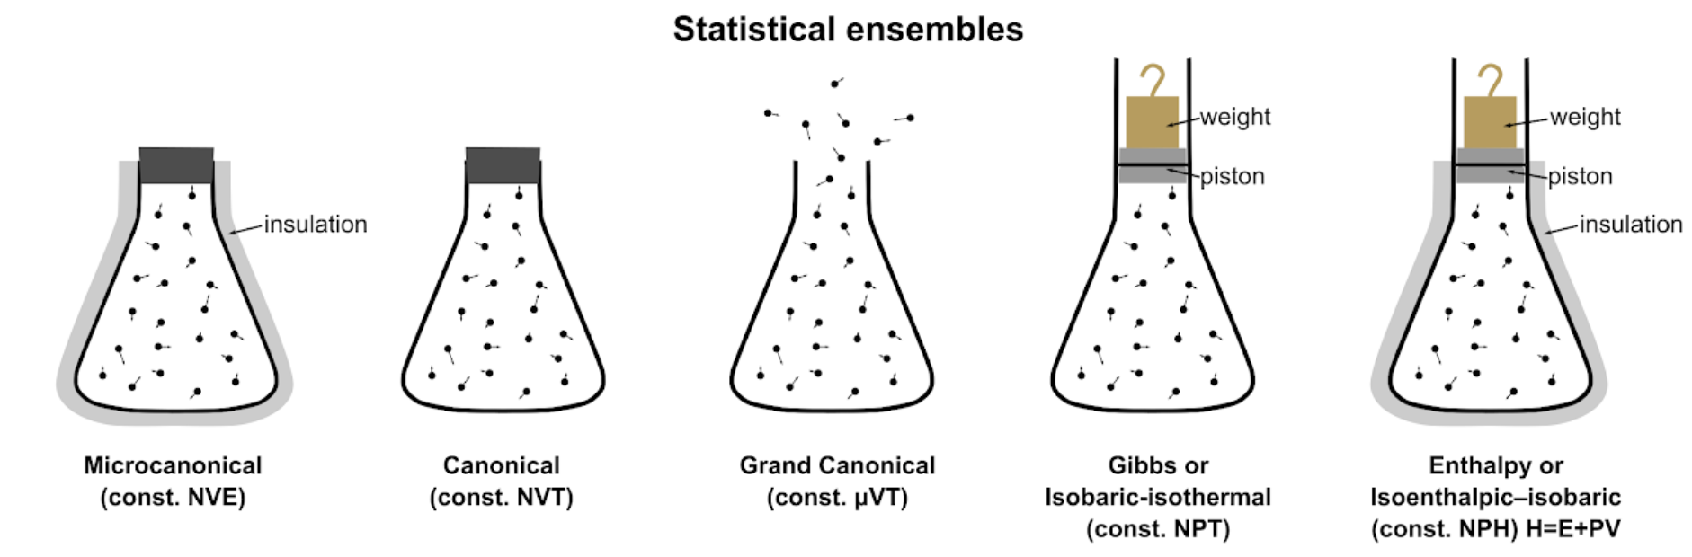
Hands-on example:
NVE ensemble (microcanonical):
Constant energy, number of particles and volume
NVT ensemble (canonical):
Constant temperature, number of particles and volume
NPT ensemble (Isobaric-Isothermal):
Constant temperature, number of particles and pressure

Slide 9
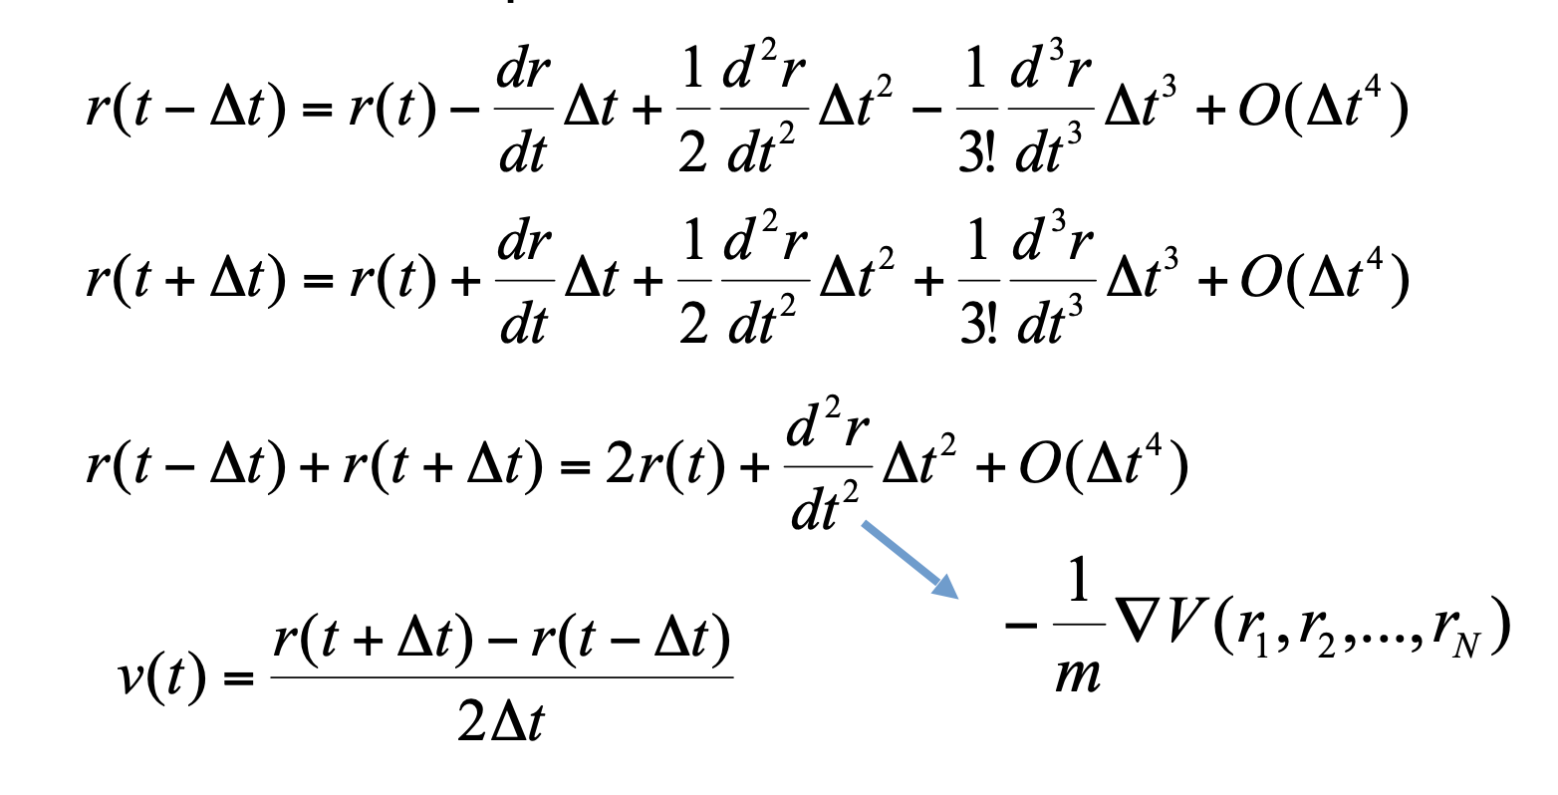
Hands-on example:
Verlet Algorithm:

Slide 10
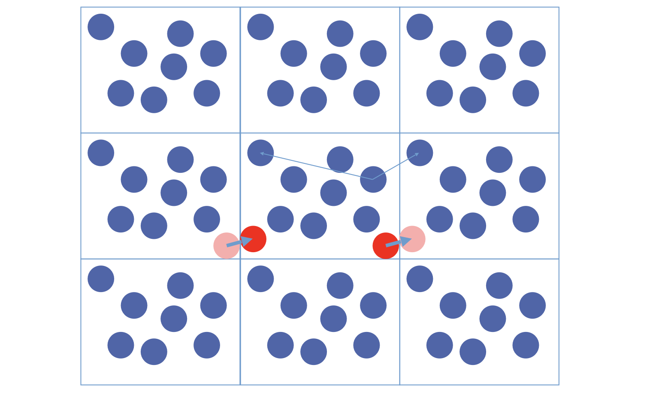
Hands-on example:
Periodic boundary condition:

Slide 11
Hands-on example:
Periodic boundary condition:
In which case working with supercells for MD simulations is important!
For a simple unit cell (1 atom) we’d only be sampling an atom self-interacting, which is unphysical!

Slide 12
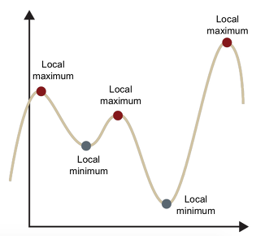
Hands-on example:
Geometry optimisation:

Slide 13
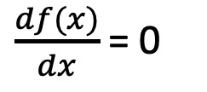
Hands-on example:
Geometry optimisation:
$\frac{df(x)}{dx}$ = 0

Slide 14
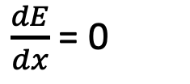
Hands-on example:
Geometry optimisation:
$\frac{df(x)}{dx}$ = 0
$\frac{dE}{dx}$ = 0

Slide 15
Hands-on example:
Geometry optimisation:
$\frac{df(x)}{dx}$ = 0
$\frac{dE}{dx}$ = 0
Force
Force is our convergence criteria!

Slide 16
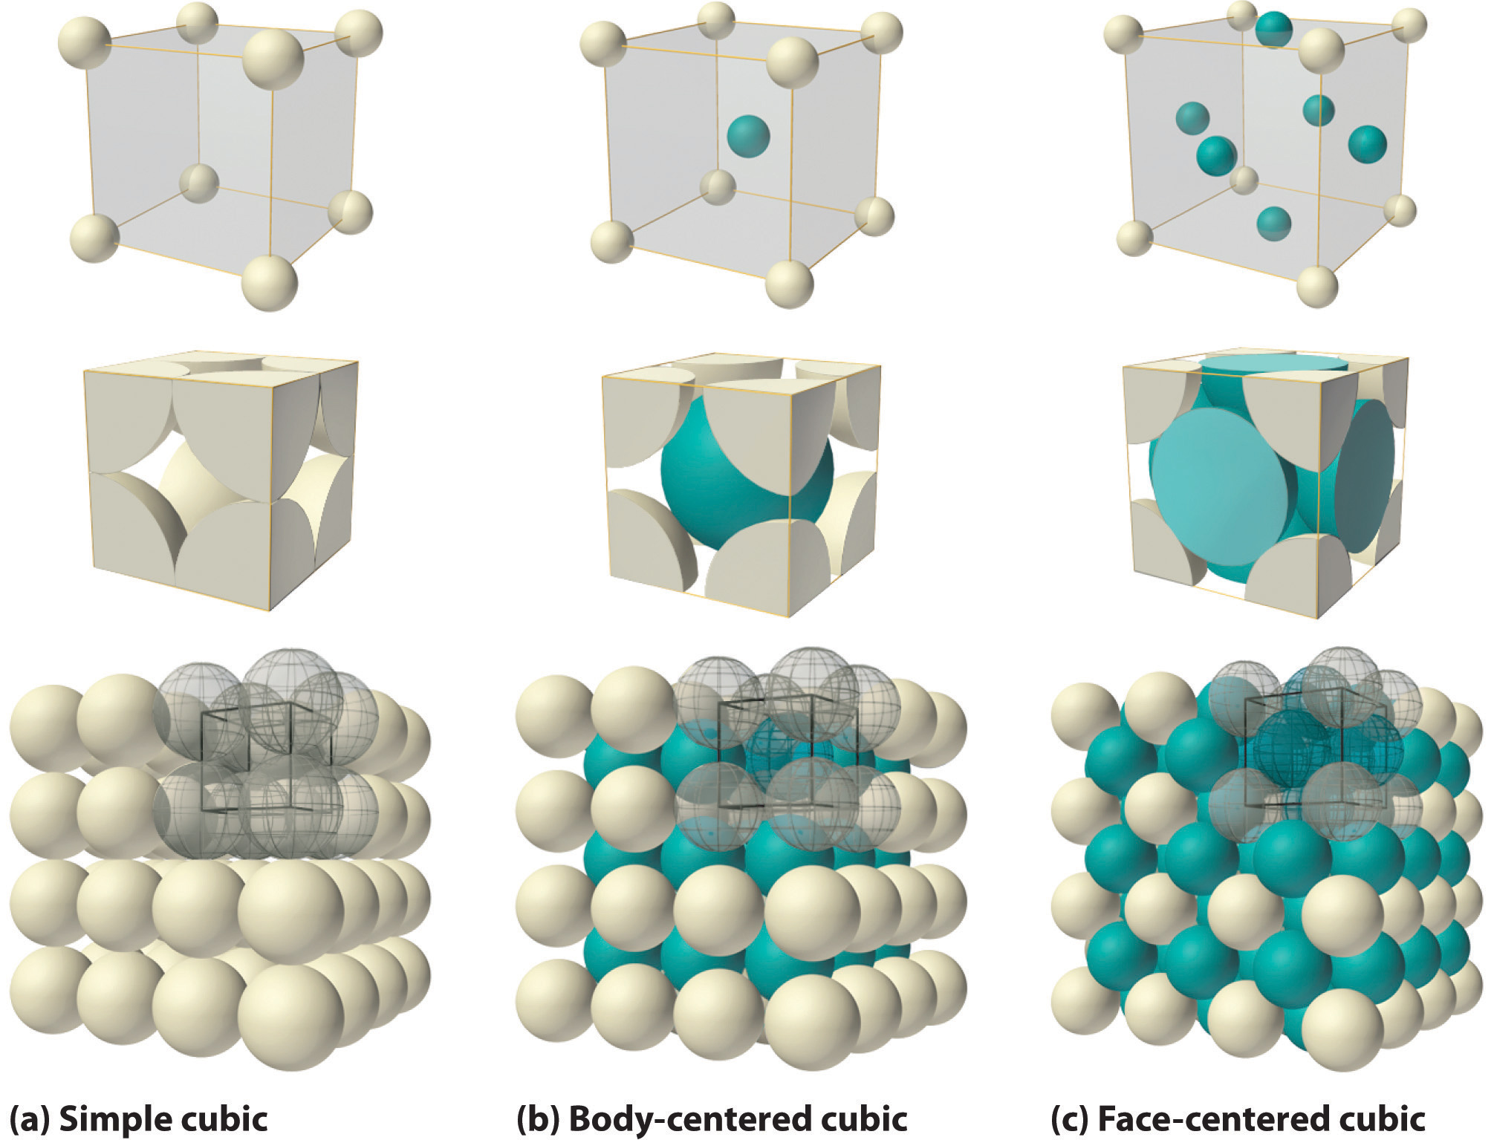
Hands-on example:
Cubic lattices:

Slide 17
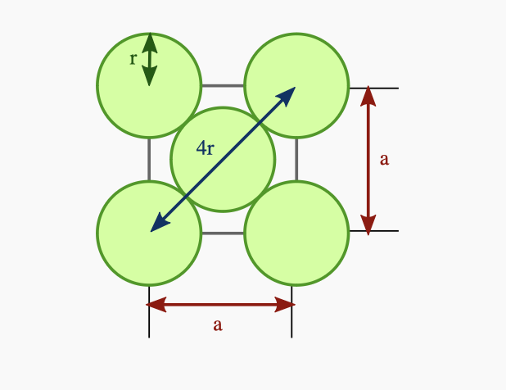
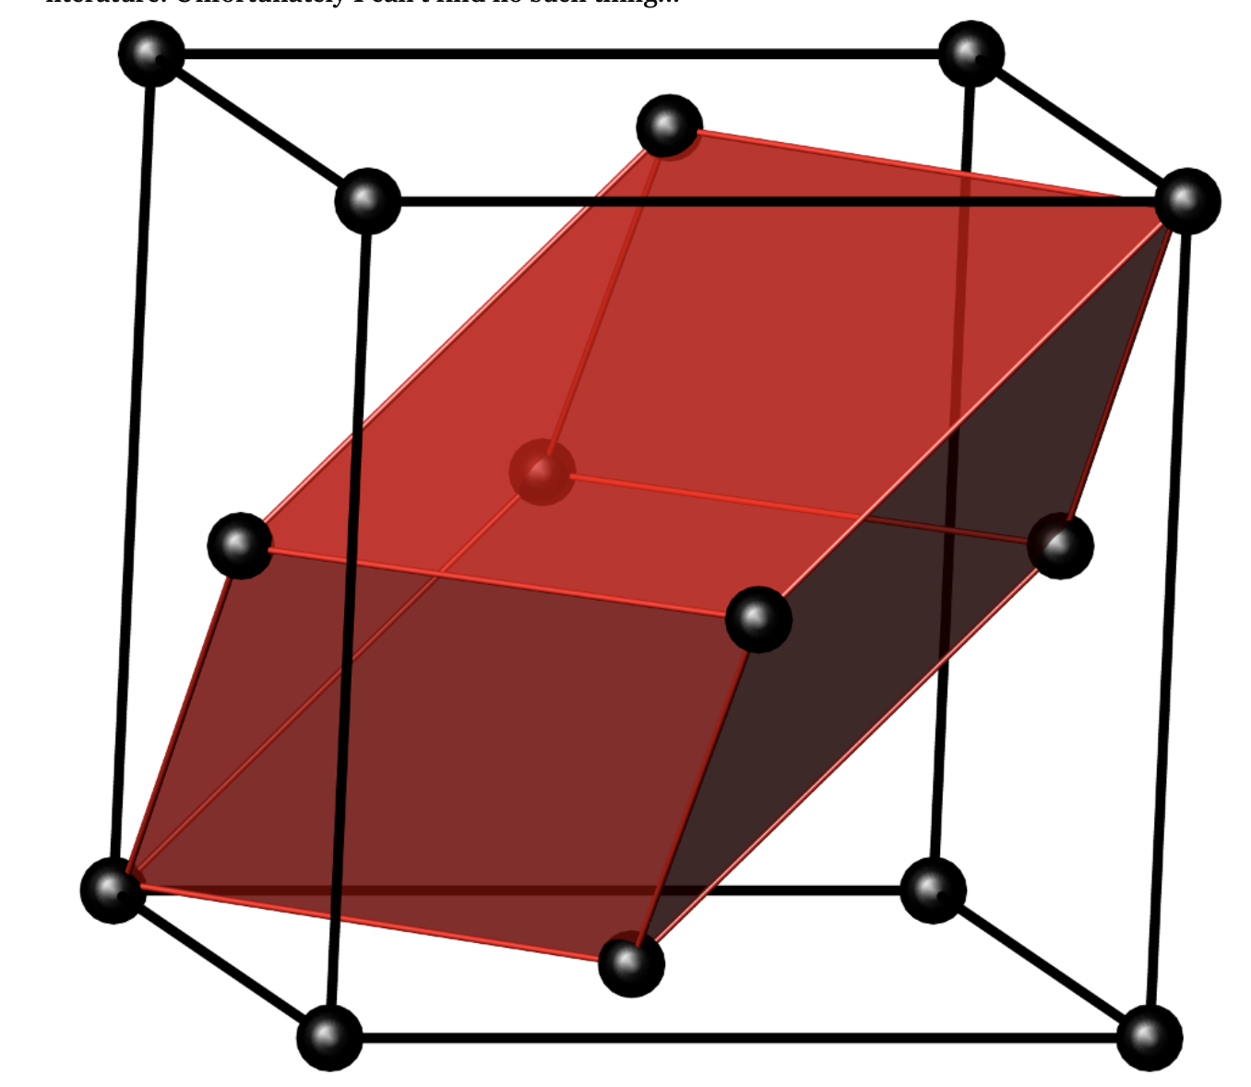
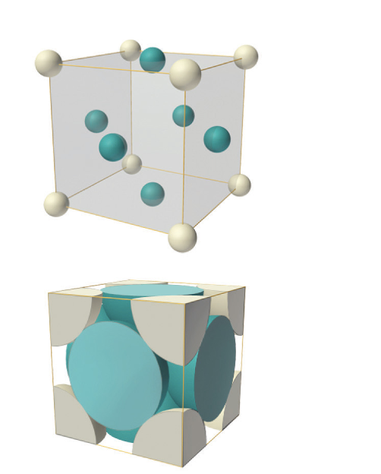
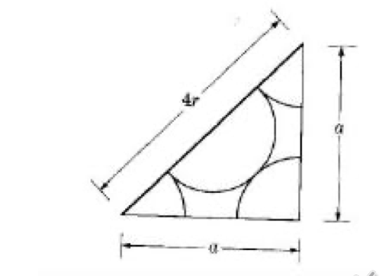
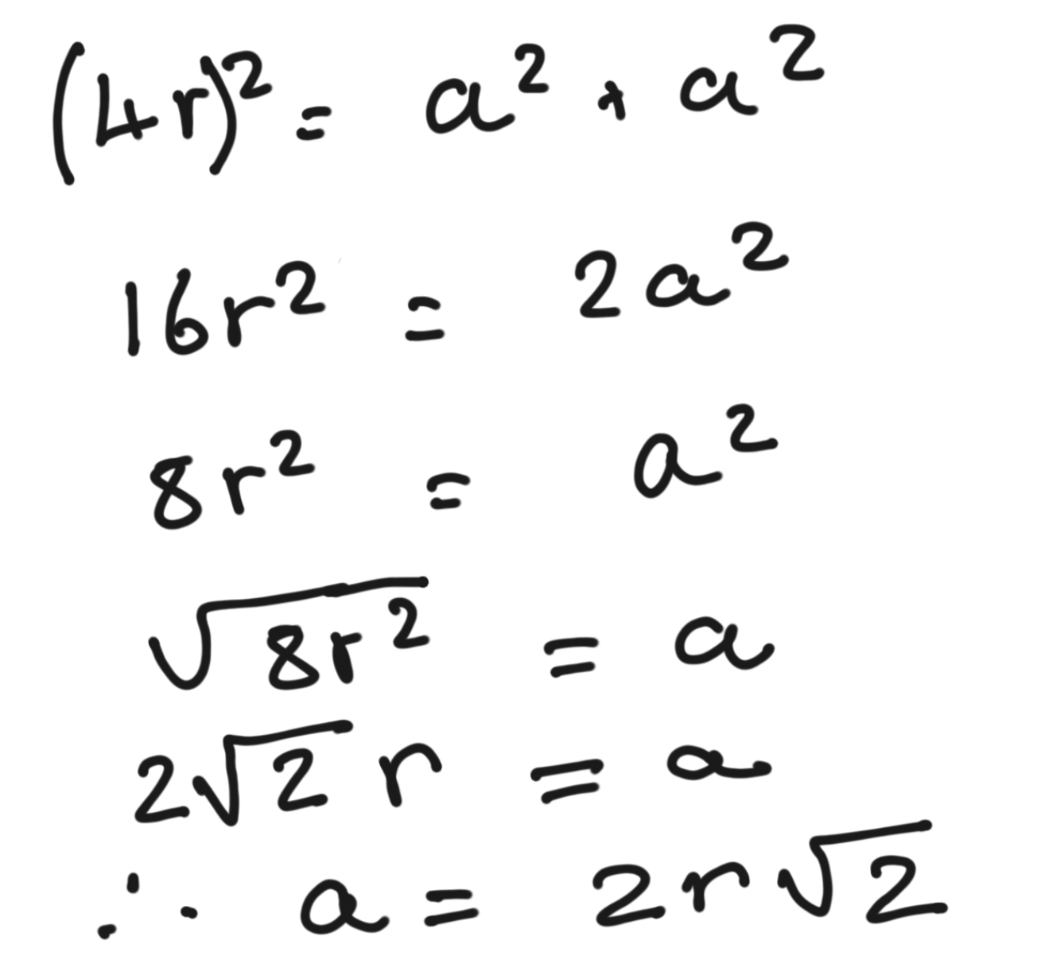
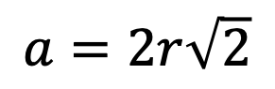
Hands-on example:
FCC
Primitive unit cell
$$a=2r\sqrt{2}$$
Conventional unit cell

Slide 18
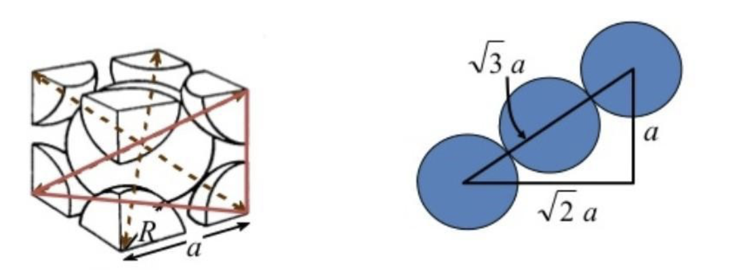
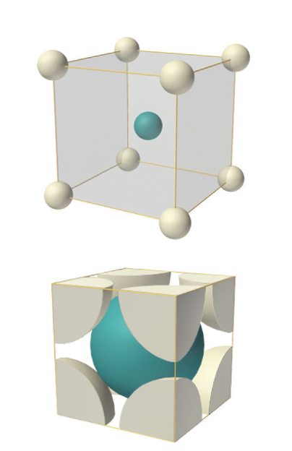
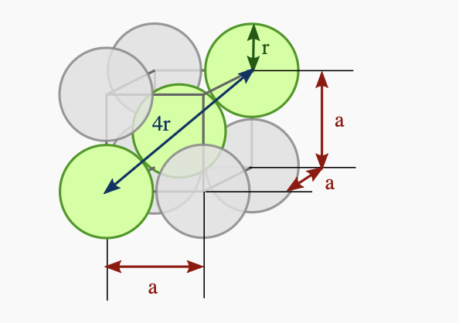
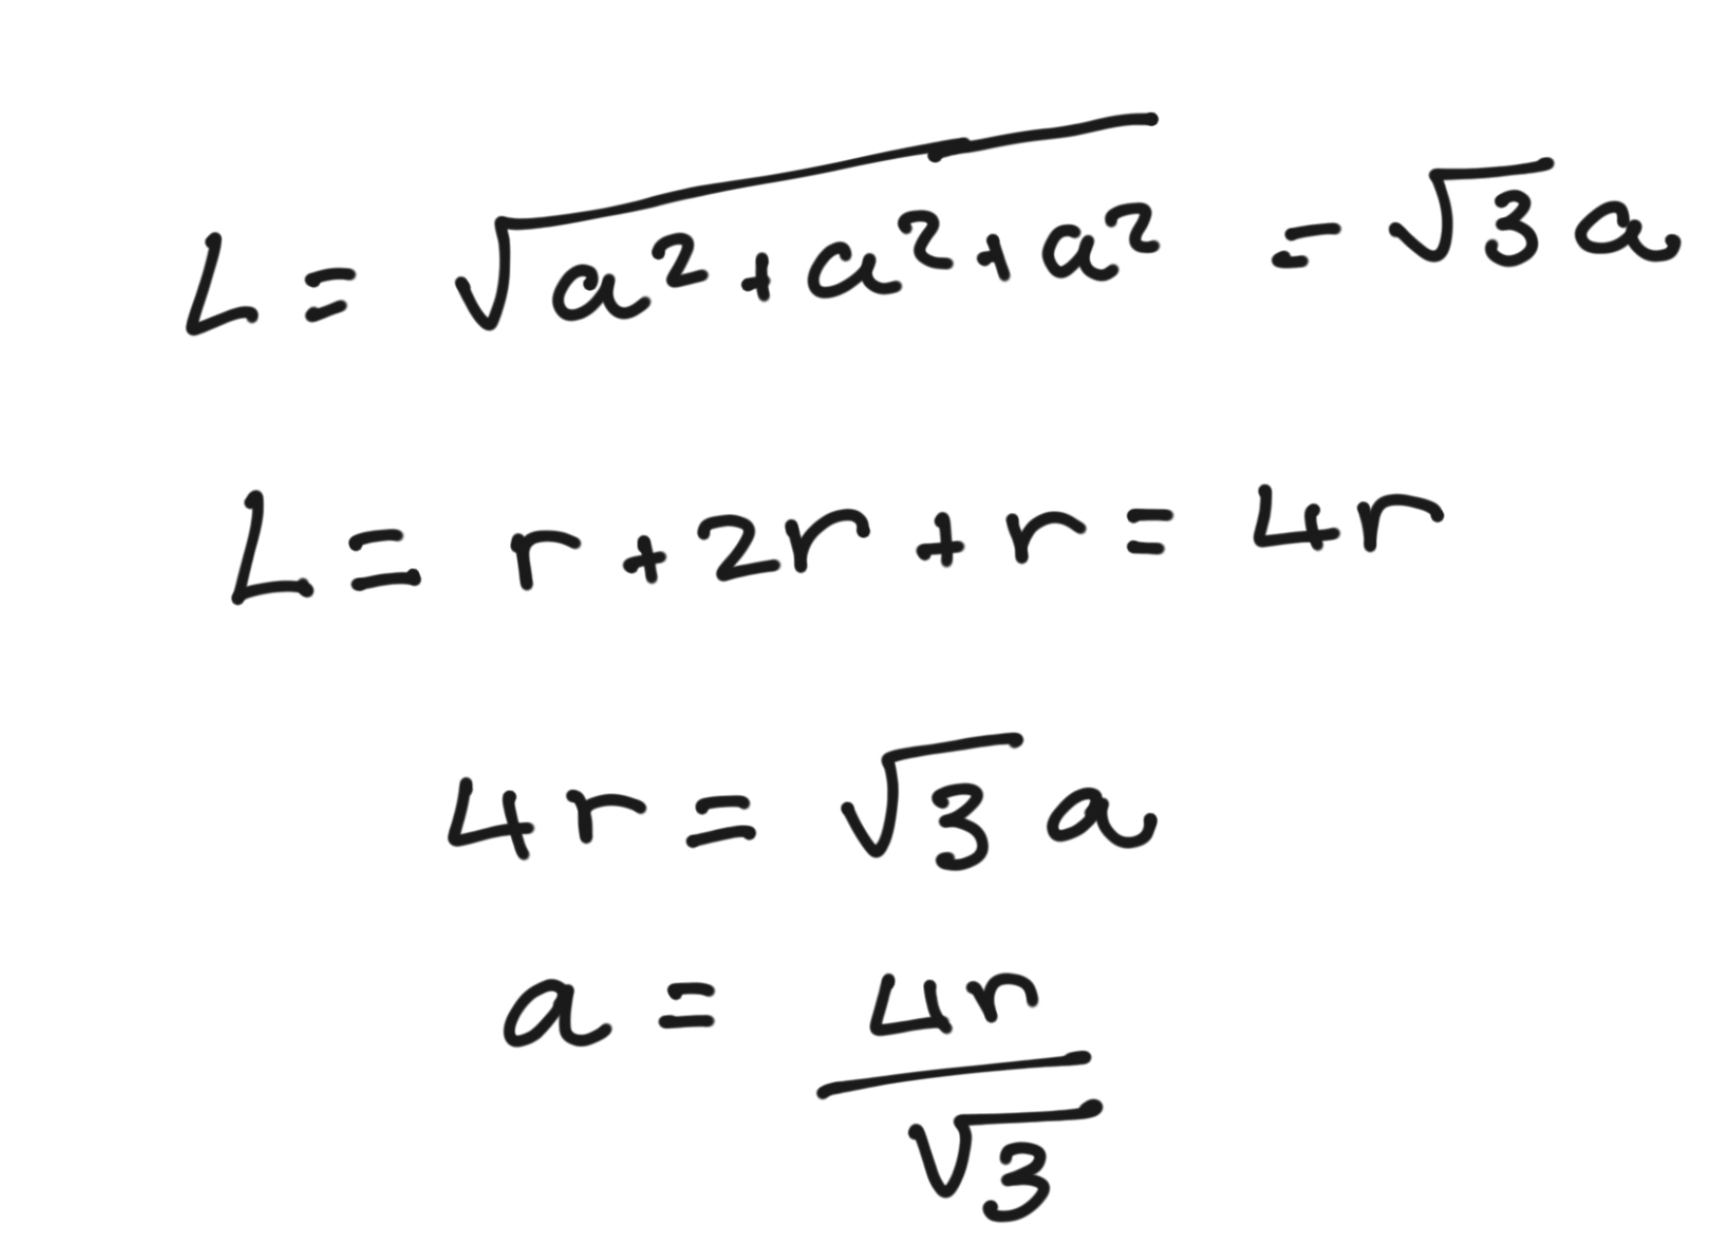
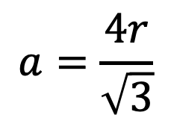
Hands-on example:
BCC
$$a=\frac{4r}{\sqrt{3}}$$

Slide 19
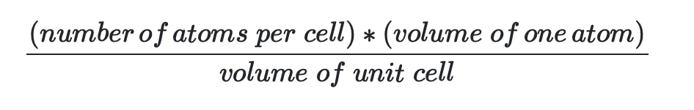
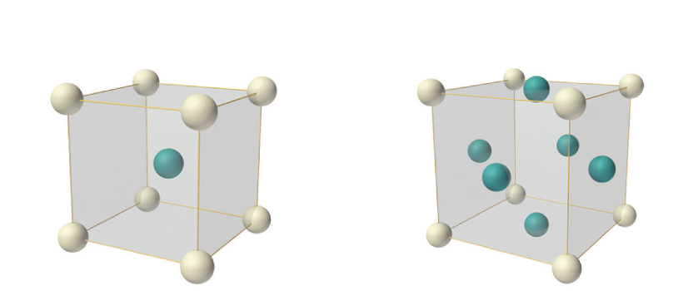
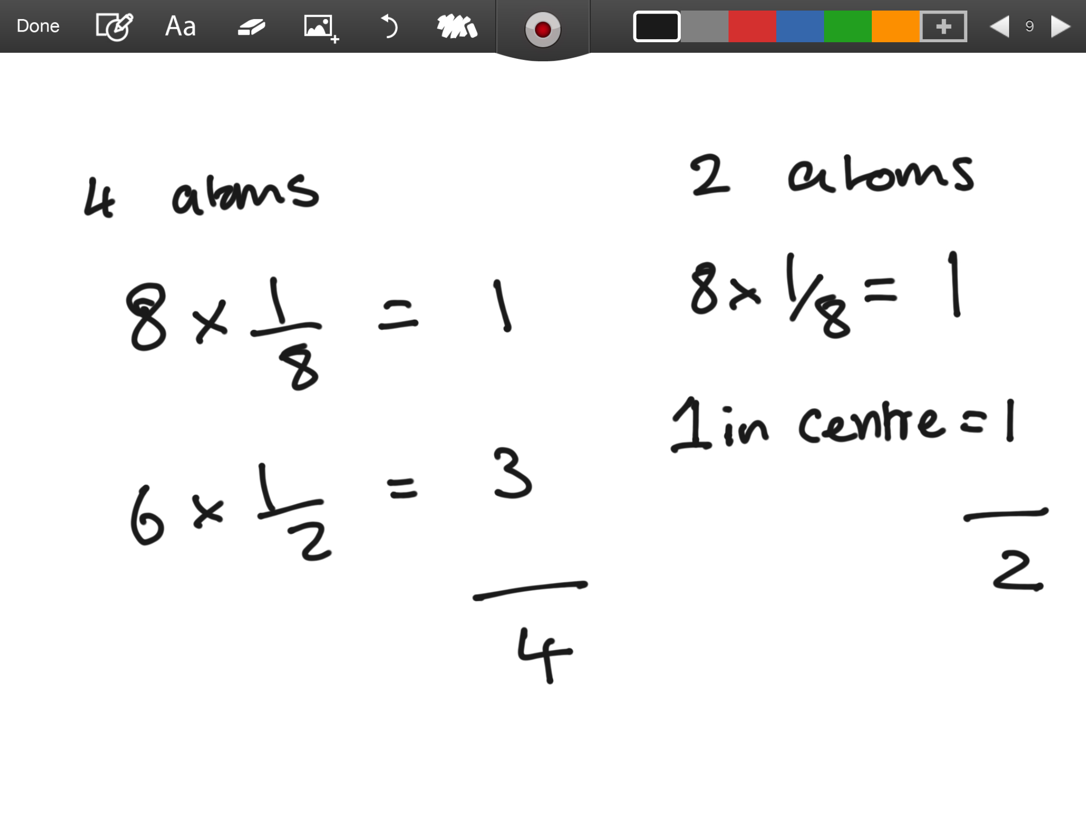
Hands-on example:
Packing efficiency:
4 atoms in unit cell
For FCC: 74%
For BCC: 68%
2 atoms in unit cell

Slide 20
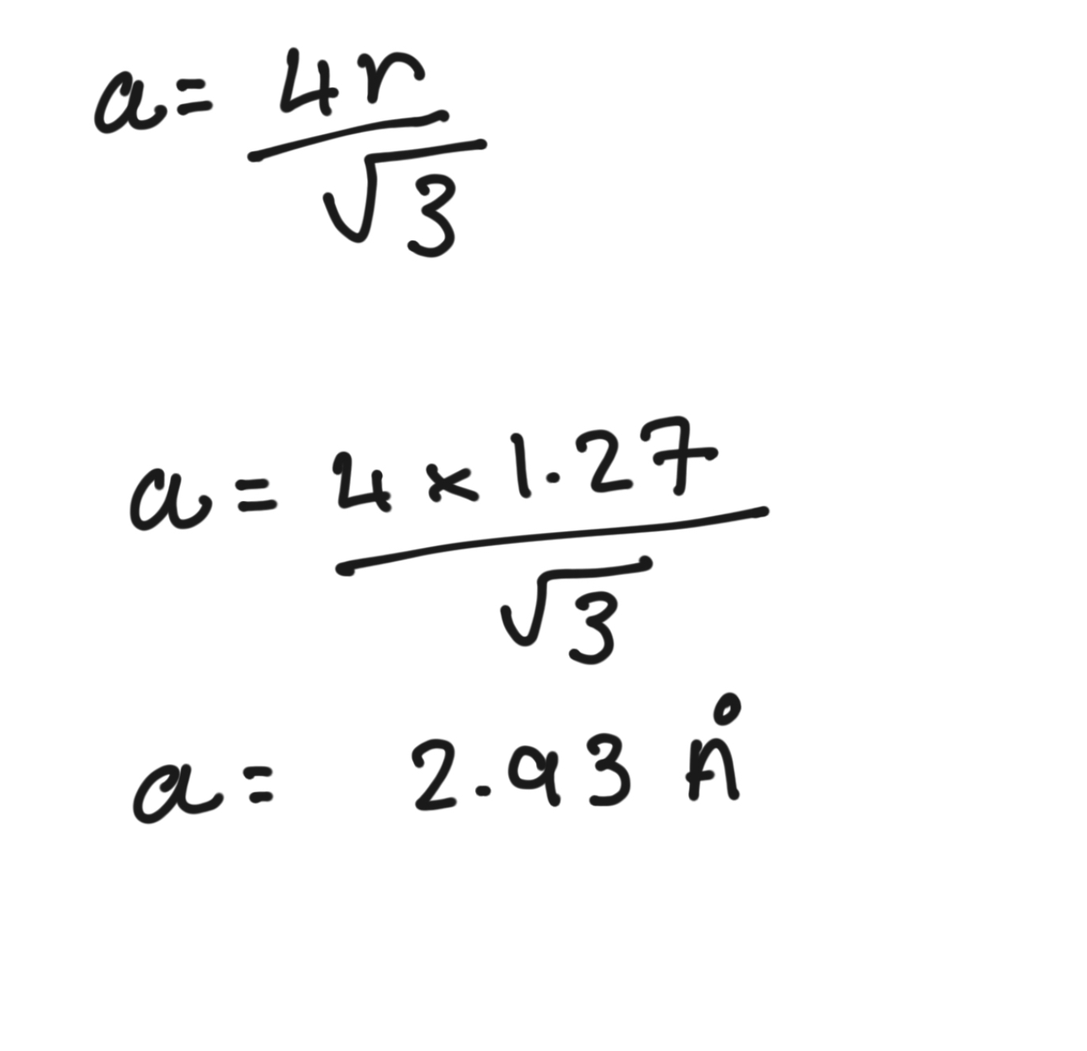
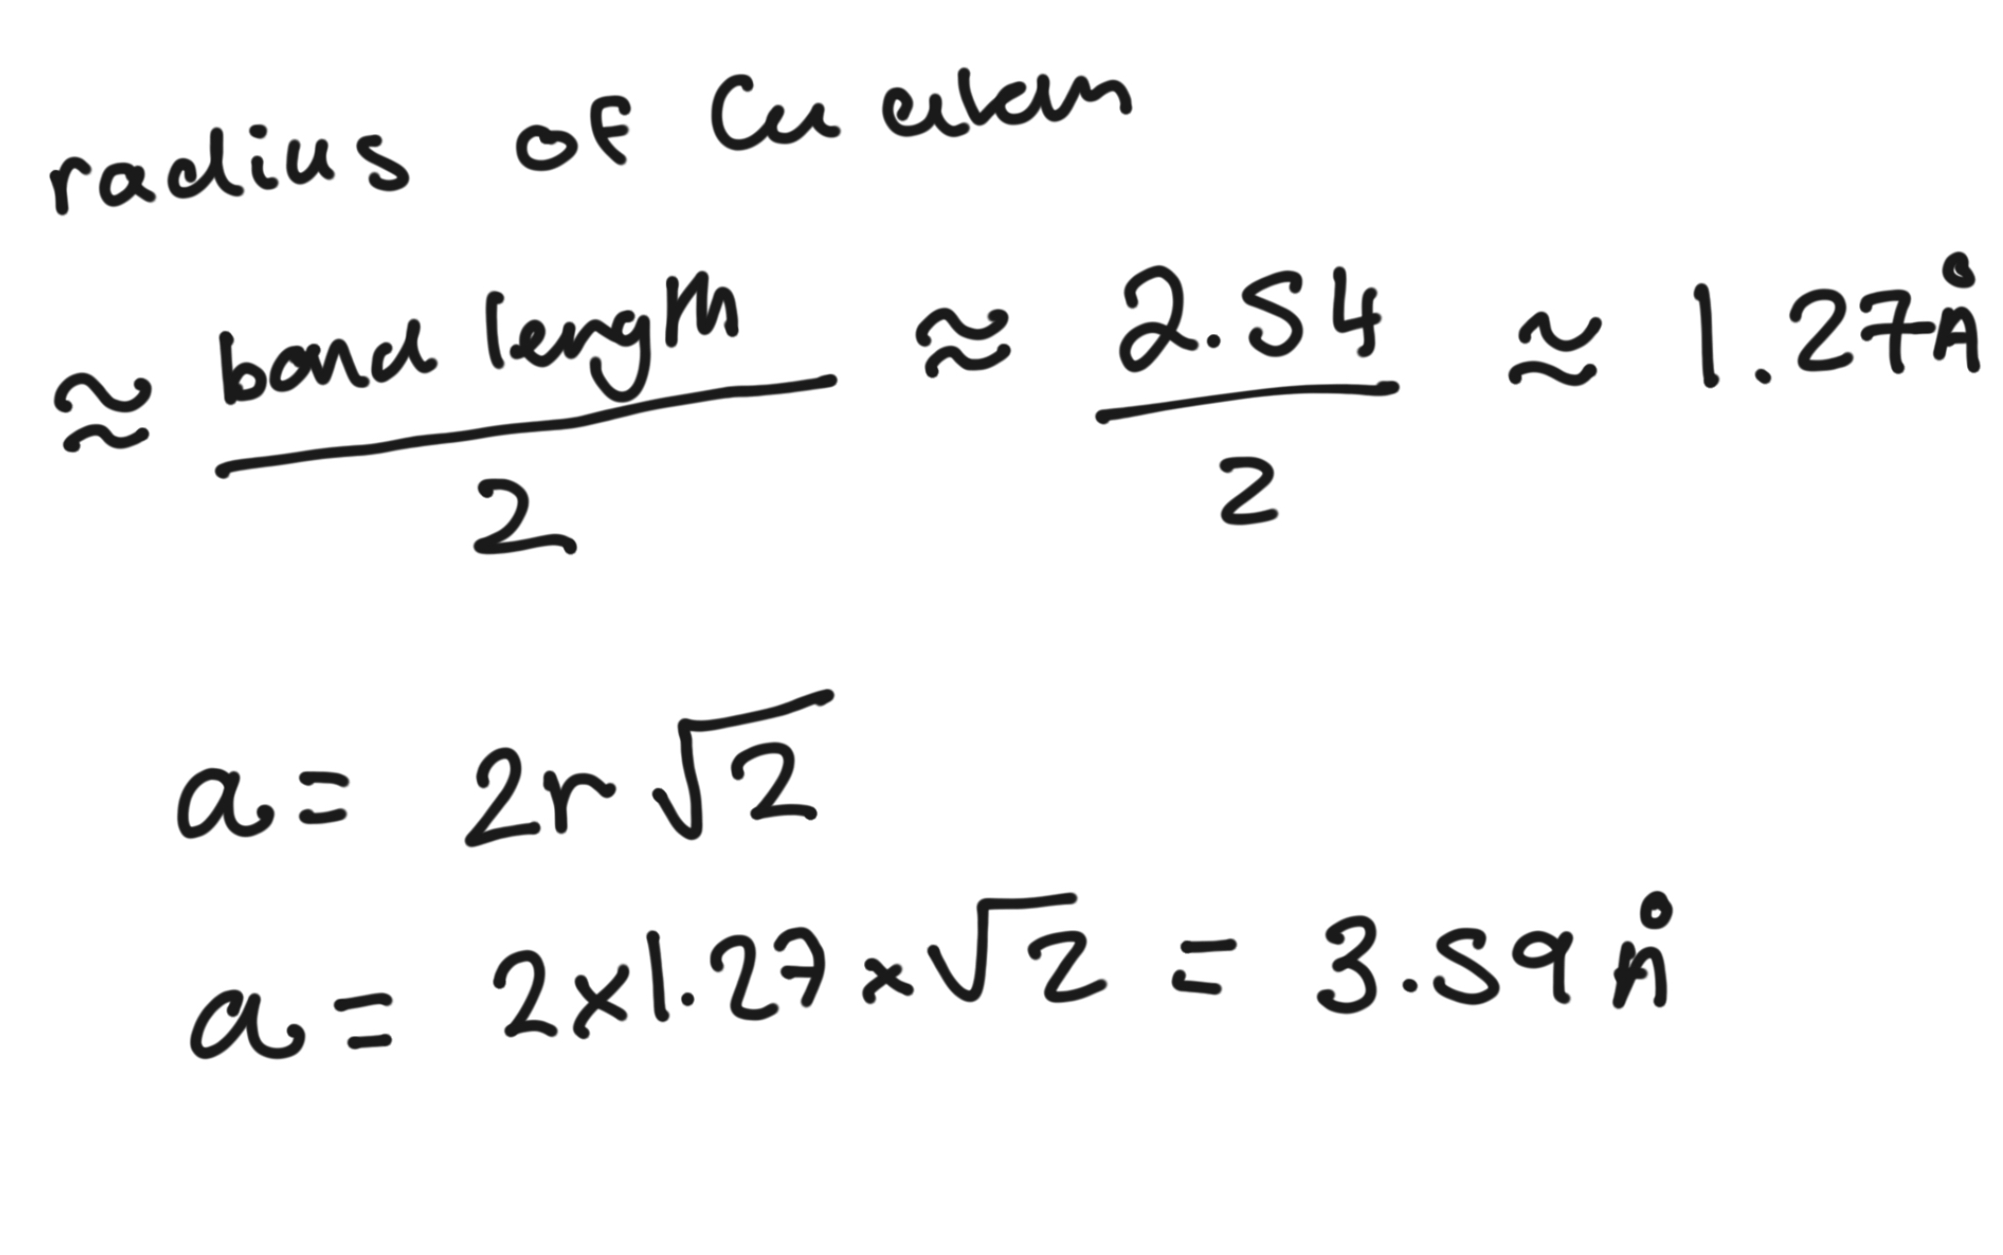
Hands-on example:
Deriving lattice constants :
FCC
BCC
For this, we approximate that the radius of a Cu atom is half the Cu-Cu bond length

